Slide 1

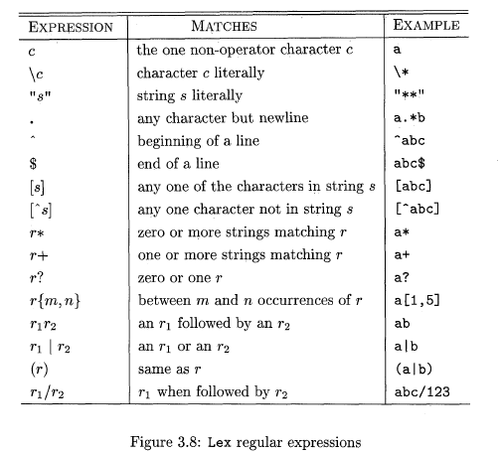
Lex regular expressions
Notes:
1

